Slide 1

FUTURE READY STARTS HERE...
...empowering Youth for a Rapidly Changing World

Slide 2

One World’s Future Ready
Educational Enrichment Programs
Goals for Today
Overview of the Hinge of History & The Need for the Conversation
Discuss Program Logistics
Initial Thoughts on the Need For This Kind of Conversation

Slide 3
First Global Conversation on Future of Humanity
We Ask for Your Patience and Input
Our Hope is that this Conversation on the Future of Humanity Marks a Turning Point in the Evolution of our Species
As this is the First Time We have Attempted to Deliver a Global Program of this Nature we ask for your Patience and Constructive Input and Feedback throughout this process.

Slide 4
The Four C’s for 21st Century
Critical Thinking, Creativity, Communication, Collaboration
Our Our goal as with all of our programs is to encourage you to use your Critical Thinking skills, be Creative in Finding Solutions and Communicate those solutions effectively. But our principal goal here is to Collaborate, Collaborate,Collaborate, Collaborate and Collaborate Some More!!

Slide 5
Our Hope is That This Program a Transformative Impact and Want To Recognize Your Participation
All Participants Will Receive a Certificate from One World confirming their participation in this historic exercise.
We Also Intend to Publish a Second Online Book at the end of this Process and will name all of those interested in putting their name to this project.

Slide 6
One World's Fundamental Values
All human beings alive today and yet to be born share an essential human connection.
Humanity needs new forms of global cooperation at this pivotal time in human history if we are to survive and prosper.
We need to generate respectful, fallible conversations to understand the full potential for abundance in our increasingly complex world.

Slide 7
Welcome to the One World Family!
Vision: One World 2050: if,if,if we manage to keep civilization intact until 2050 every human being alive then will have the potential to live better than the billionaires of today.
THE IF KEEPS ON GETTING BIGGER AND MORE UNCERTAIN!!! BY THE MONTH !!!
Mission: Use our Future Ready programs to prepare global K-12 youth for 21st century individual and societal success.
Goal: to create a global coalition for Sustainable Super Abundance

Slide 8
Living at the Hinge of History
Oxford Professor Derek Parfit 2011 On What Matters
“We live during the hinge of history.
Given the scientific and technological discoveries of the last two centuries, the world has never changed as fast. We shall soon have greater powers to transform, not only our surroundings, but ourselves and our successors.
If we act wisely in the next few centuries, humanity will survive its most dangerous and decisive period. Our descendants could, if necessary, go elsewhere, spreading through this galaxy.”
Oxford professors Derek Parfit who wrote in the final pages of On What Matters (2011)

Slide 9
Living at the Hinge of History Derek Parfit Oxford Union Speech 2015
“I think that we are living now at the most critical part of human history. The twentieth century I think was the best and worst of all centuries so far, but it now seems fairly likely that there are no intelligent beings anywhere else in the observable universe.
Now, if that’s true, we may be living in the most critical part of the history of the universe…

Slide 10
Living at the Hinge of History
Derek Parfit Oxford Union Speech 2015
(The reason) why this may be the critical period in the history of the universe is we are the only rational intelligent beings, its only we who might provide the origin of what would then become a galaxy-wide civilization, which lasted for billions of years, and in which life was much better than it is for most human beings.
Well, if you look at the scale there is between human history so far and what could come about, its enormous. And what’s critical is that we could blow it, we could end it.”

Slide 11
Living at the Most Important Time
Since the Big Bang!!
”It may not be absurd hyperbole - indeed, it may not be an overstatement - to assert that the most crucial location in space and time (apart from the big bang itself) could be here and now.
Sir Martin Rees, in his 2003 book Our Final Century
Former President of the Royal Society of Science and Astronomer Royal
“

Slide 12
Our Cosmic Choice
“Our choices and actions could ensure the perpetual future of life (not just on Earth, but far beyond it too).
Or in contrast, through malign intent or misadventure, twenty-first century technology could jeopardize life’s potential, foreclosing its human and posthuman future.
What happens here on Earth, in this century, could conceivably make the difference between a near eternity filled with ever more complex and subtle forms of life and one filled with nothing but base matter. ”
Sir Martin Rees: Our Final Century

Slide 13
Our Cosmic Choice
Doomsday Clock: Going the Wrong Way
One Independent Measure of the Existential Risks we Face Comes from an Organization In Part Created by Eintein and Oppenheimer the Bulletin of the Atomic Scientists.
According to the Bulletin Our World is 5x More likely To Bring an End to Human Civilization than When Lord Rees’ Book Was Published
This Year the Bulletin Moved the Doomsday Clock to 85 Seconds to Midnight More Dangerous Than at Any Time in Human history.
You can read their statement here: https://thebulletin.org/wp-content/uploads/2026/01/2026-Doomsday-Clock-Statement.pdf

Slide 14
Deep Utopia: Living Into a Solved World?
Sustainable Super Abundance
At the Same Time Dramatic Advances in AI and Technology have Provided Humanity With an Opportunity to Create a Post Scarcity World of Universal High Income Where we Eliminate Poverty, Hunger, Disease and even the Need to Work
Would you like to end poverty? Disease?
Never work another day in your life?

Slide 15
Sustainable Super Abundance
Eliminate Poverty as Work Becomes Optional
Elon Musk tells us that in 10 to 20 years AI and Humanoid Robots will Eliminate Poverty amd Your Need to Work.
He Sees a Future Where Work Becomes Optional
https://www.youtube.com/watch?v=NiJIpcrgEA0

Slide 16
Sustainable Super Abundance
Eliminate Disease??
Demis Hassibis, Co-Founder of Google Deepmind also Sees the Potential for Radical Abundance and Even the End of Disease as we See in this 60 Minutes interview
https://www.youtube.com/shorts/aXyxsIMOtTg
The Reason He is So Confident is Because Google Solved the Protein Folding Challenge Doing in minutes and hours what had previously had taken years
Protein Folding from 170,000 in 60 years to 200 million

Slide 17
Our First Online Book
The Great Transition
The Great Transition to Sustainable Super Abundance: Uniting Humanity for a Future Where Everyone Thrives
A World of Sustainable Super Abundance is Technologically Feasible. IF, IF, IF. We Use the Tools – The Technology - Now Available to us Wisely We Can End Poverty, Disease & the Need to Work
You can access the full book here: The Great Transition
Or listen to this 15 minute: Podcast of the Book

Slide 18
Our First Global Project
The Great Transition: We Need Your Help!!
While We Concluded that a World of Super Abundance is Technologically Feasible, We Do Not Believe our Global Society is Ready or Prepared to Engineer the Needed Transition.
The AI Opportunity Has Been Launched on a Divided World of Intense Global Competition between Trillion Dollar Companies and Leading Superpowers

Slide 19
Our First Global Project
The Great Transition: We Need Your Help!!
Moreover, the Futurists Paint a Sort of Utopian View of the Future Without Ever Telling us How We Get from Here to There
How Do We Go from Today’s World of 193 Competing Nation States Armed to the Teeth Spending $2.7 Trillion to Defend Against their Neighbors to a World Without Poverty, Disease and Hunger?
Our Goal in Generating this Global Conversation on the Future of Humanity is to Fill the Gap Left by the Futurists.
We Want to Work Together with you to Develop Pathways and Roadmaps to Super Abundance

Slide 20
Your Mission if You Decide to Accept It
We Are Going to Assume there is a President of the World and She has Asked you to Pull Togther a Plan, a Roadmap to Help Get Humanity from Here – a Post Scarcity World of 193 Competing Nation States to the World of Sustainable Super Abundance Foretold by the Futurists.
The President Wants a Concrete, Plan or Vision of How We Get From Here to There with the Focus Being on the Plan and Pathways that Get us To Abundance

Slide 21
Support for Your Mission – Monthly Webinars
Monthly Webinars at 8 am EST to Support Your Mission
March 21,
April 18
May 16
March 21 – Deep Dive in AI What is it Really? For all of the hype AI is not well understood. This first webinar will go into depth in an effort to come up with a clear view of AI and how we expect it to evolve.

Slide 22
Support for Your Mission
Via Global Conversations via Padlet
We Will Organize an Opportunity to Communicate Across our Platform via Padlet
Youth Educator Platform
Adult Participant Platform
And Then Organize Periodic Exchanges as Momentum Builds
Padlet Training Available

Slide 23
Final Report Due June 20th
The President is Asking for a 3 to 5 page memo explaining how she should use her immense powers to engineer a transition from our disconnected, zero-sum mindset world of scarcity to the post-scarcity, of abundance envisioned by the futurists.
We will ask you to present your principal findings in a 5 to 8 minute presentation on June 20th once again starting at 8 am EST.

Slide 24
Is This Kind of Conversation Needed?

Slide 25

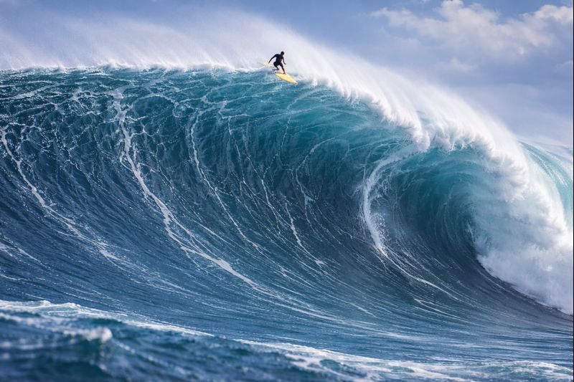
We NEED TO PREPARE OUR STUDENTS AND COMMUNITIES FOR THE TECH WAVE OF OPPORTUNITY .ASAP!!
Caption

